Slide 1

Delivers answers
engineers can trust
Engineering
Decision-Support
Solution
Integrates technical reference content with analytical & search tools

Slide 2
Smart Content & Analytics
Workflow Integrations
Material Solutions
Information Essentials

Slide 3








Text Sections
Interactive Graphs
“automobile engines”
Automobile Engines
Figure 13-4. (a) Full-throttle performance of 1982 spark-ignition automobile…
…automobile engines automobiles 629 the engine factory or purchased, are included in the assembly. These include parts that may be stamped from sheet metal (2C and 2D), die cast (IF), or molde… more>>
(98 hits)
from Handbook of Manufacturing Processes - How Products, Components and Materials are Made (2007)
TECHNICAL REFERENCES
#
x-axis
y-axis
graph title
text
graph digitizer
354
All Technical References
Text Sections (318)
Conference Proceedings (12)
Interactive Graphs (2)
Regulatory Information (2)
Interactive Tables (1)
CLICK LINK TO VIEW THE TABLE
See more results from this site I Search within this site >>
Text Sections
8.1.1 Automobile Engines
Search within this title >>
…Automobile engines Although some Trabant and Wartburg vehicles may still exist in central Europe today, and three wheeled motorized rickshaws can be found in many developing countries, the ea… more >>
from Automotive Lubricants Reference Book (2nd Edition) (2004)
Interactive Graphs
Figure 9. Typical carbon and silicon ranges for ductile iron castings.
(1 hits)
See more results from this site I Search within this site >>
#
x-axis
y-axis
graph title
text
graph digitizer
Text Sections
EXTERNAL LINKS
13.4 Supercharging of Automobile Engines
538
CLICK LINK TO VIEW THE TABLE
Compendex from Engineering
Village >>
…sizes ranging up to about 500 hp. When supercharged, they use turbo rather than gear-driven superchargers (see Volume 2, table 10-15, p.421). 145 - 147). SUPERCHARGING OF AUTOMOBILE ENGINES S…more>>
from ASM Handbook, Volume 15 - Casting
from Internal-Combustion Engine in Theory and Practice, Volume 1- Thermodynamics, Fluid Flow, Performance (2nd Edition, Revised) (1985)
Search within this title >>
See more results from this site I Search within this site >>

Slide 4
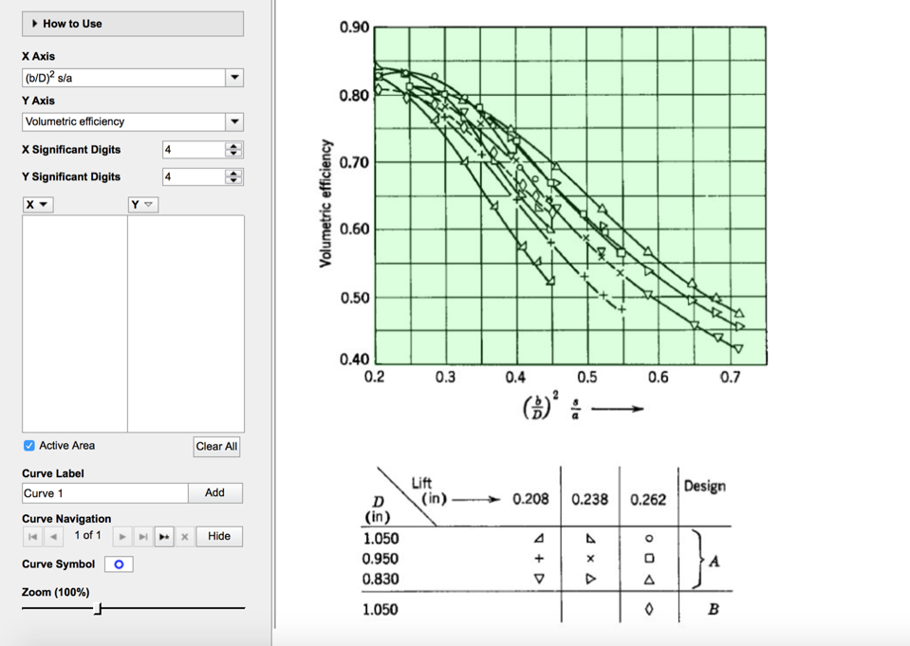
Interactive Graphs
“automobile engines”
Figure 13-4. (a) Full-throttle performance of 1982 spark-ignition automobile…
(98 hits)
TECHNICAL REFERENCES
#
x-axis
y-axis
graph title
text
graph digitizer
354
All Technical References
Text Sections (318)
Conference Proceedings (12)
Interactive Graphs (2)
Regulatory Information (2)
Interactive Tables (1)
CLICK LINK TO VIEW THE TABLE
Search within this title >>
Interactive Graphs
Figure 9. Typical carbon and silicon ranges for ductile iron castings.
(1 hits)
#
x-axis
y-axis
graph title
text
graph digitizer
EXTERNAL LINKS
538
CLICK LINK TO VIEW THE TABLE
Compendex from Engineering
Village >>
from ASM Handbook, Volume 15 - Casting
Search within this title >>

Slide 5
Interactive Features bring technical reference content to life.

